Slide 1
Metrics for Process and Products
Name: Shiva kumar
Section :- cse ( c )
Roll no: 227r1a05j3

Slide 2





Contents
Introduction
Whats is metrics and Its Types
Importance of metrics
Challenges
Conclusion

Slide 3
What is metrics
Metrics is a way to measure the quality and health of your software development process.
In software engineering,metrics plays a crucial role.
They help us understand how efficiently we are developing software and the quality of the software we are building

Slide 4
Importance of Metrics
Metrics provide data-driven insights into software development processes and products.
They help us make informed decisions, identify and address potential issues early on.
Metrics can be used to track progress, measure efficiency, and assess quality.By analyzing metrics, we can continuously improve software development practices.

Slide 5
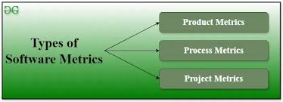
Types of metrics

Slide 6
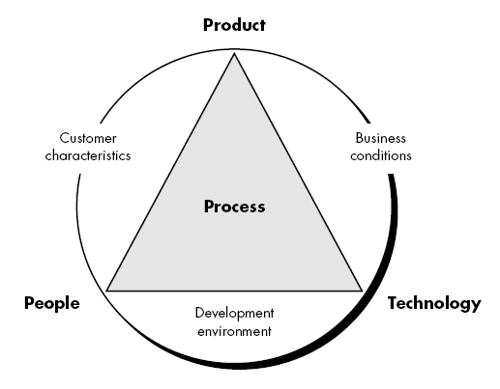
Process Metrics
Process metrics provide insights into the development workflow, resource utilization, and overall efficiency.

Slide 7
This process metrics include:
Effort
Cost
Time
Quality
velocity
cycle

Slide 8
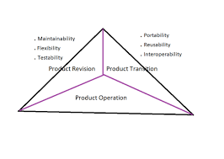
Product Matrics
Product metrics focus on the characteristics and quality of the software being built.

Slide 9
This product metrics include:
Functionality
Reliability
Usability
Performance
security

Slide 10
Challenges
Challenges can arise when using software engineering metrics.
Metrics can be misinterpreted or misused.
"Gaming the system" to make metrics look better can be counterproductive.
Focus on the right metrics and ensure everyone understands their purpose.
Metrics should be used to guide improvement, not for blame or micromanagement.

Slide 11
Conclusion
Software engineering metrics are a powerful tool for building high-quality software.
By tracking and analyzing both process and product metrics, we gain valuable insights into how we're working and what we're building.
Use metrics to make informed decisions, optimize development practices, and ultimately deliver successful software projects

Slide 12


